Slide 1

Opportunities and challenges for development
Draa Valley
+44 (0)1883 744392 www.discover-morocco-online.com
info@discover.ltd.uk

Slide 2
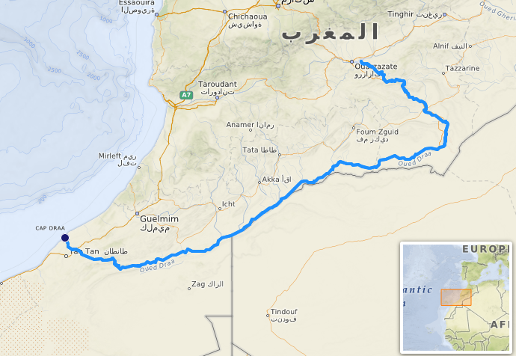
Where is the Draa valley?
The Draa is Morocco’s longest (1,100km) and one
of its most important rivers.
Rising in the High Atlas Mountains (4071m), the
Draa flows south towards the Sahara Desert and
then west to its mouth in the Atlantic Ocean.
For much of the year, the Draa runs dry as it flows
through desert in its lower course.
Several settlements have developed along the
river’s course, including Ouarzazate and Zagora.
About 225,000 people live in the Draa valley.

Slide 3
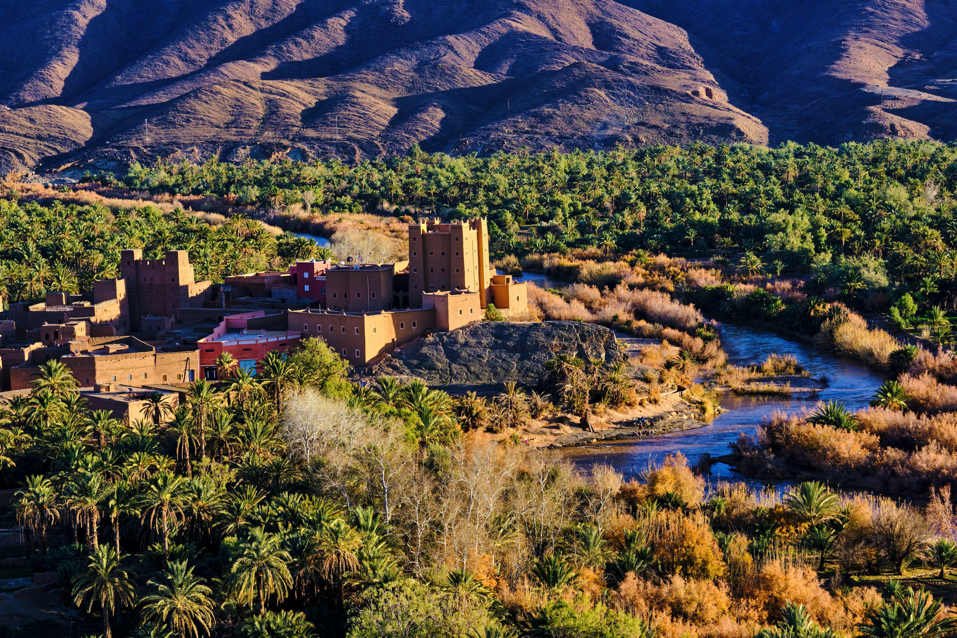
Draa valley, Ait Hamou ou Saïd Kasbah
Despite the hostile conditions, the Draa valley provides several opportunities for human activity and economic development.
Agriculture – water from the Draa is used to irrigate palm groves and small farms alongside the river
Tourism – the Draa valley, with its rich heritage and spectacular landscapes is a major tourist destination in Morocco
Film making – the world’s largest film studio is located at Ouarzazate
Resources – a huge solar farm (Noor power plant) has been constructed near Ouarzazate

Slide 4
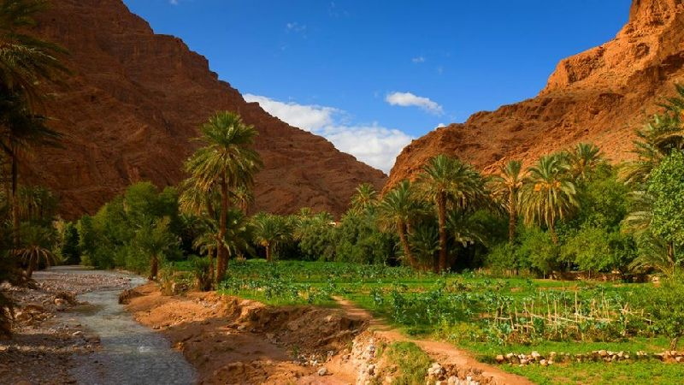
Agriculture
With its fertile soils and water available for irrigation, the Draa provides important opportunities for farming in an otherwise arid region.
The valley is especially well-known for its cultivation of date palms. 16 varieties of date are grown in the valley. The date palm industry in Morocco generates US$207 million (2019).
Other crops include vegetables, fruit and cereals, often grown on small farms.
Traditionally, land has been terraced by hand to create a series of flat fields fed by irrigation canals locally called seguias.
https://www.pinterest.com/pin/571605377688921475/

Slide 5
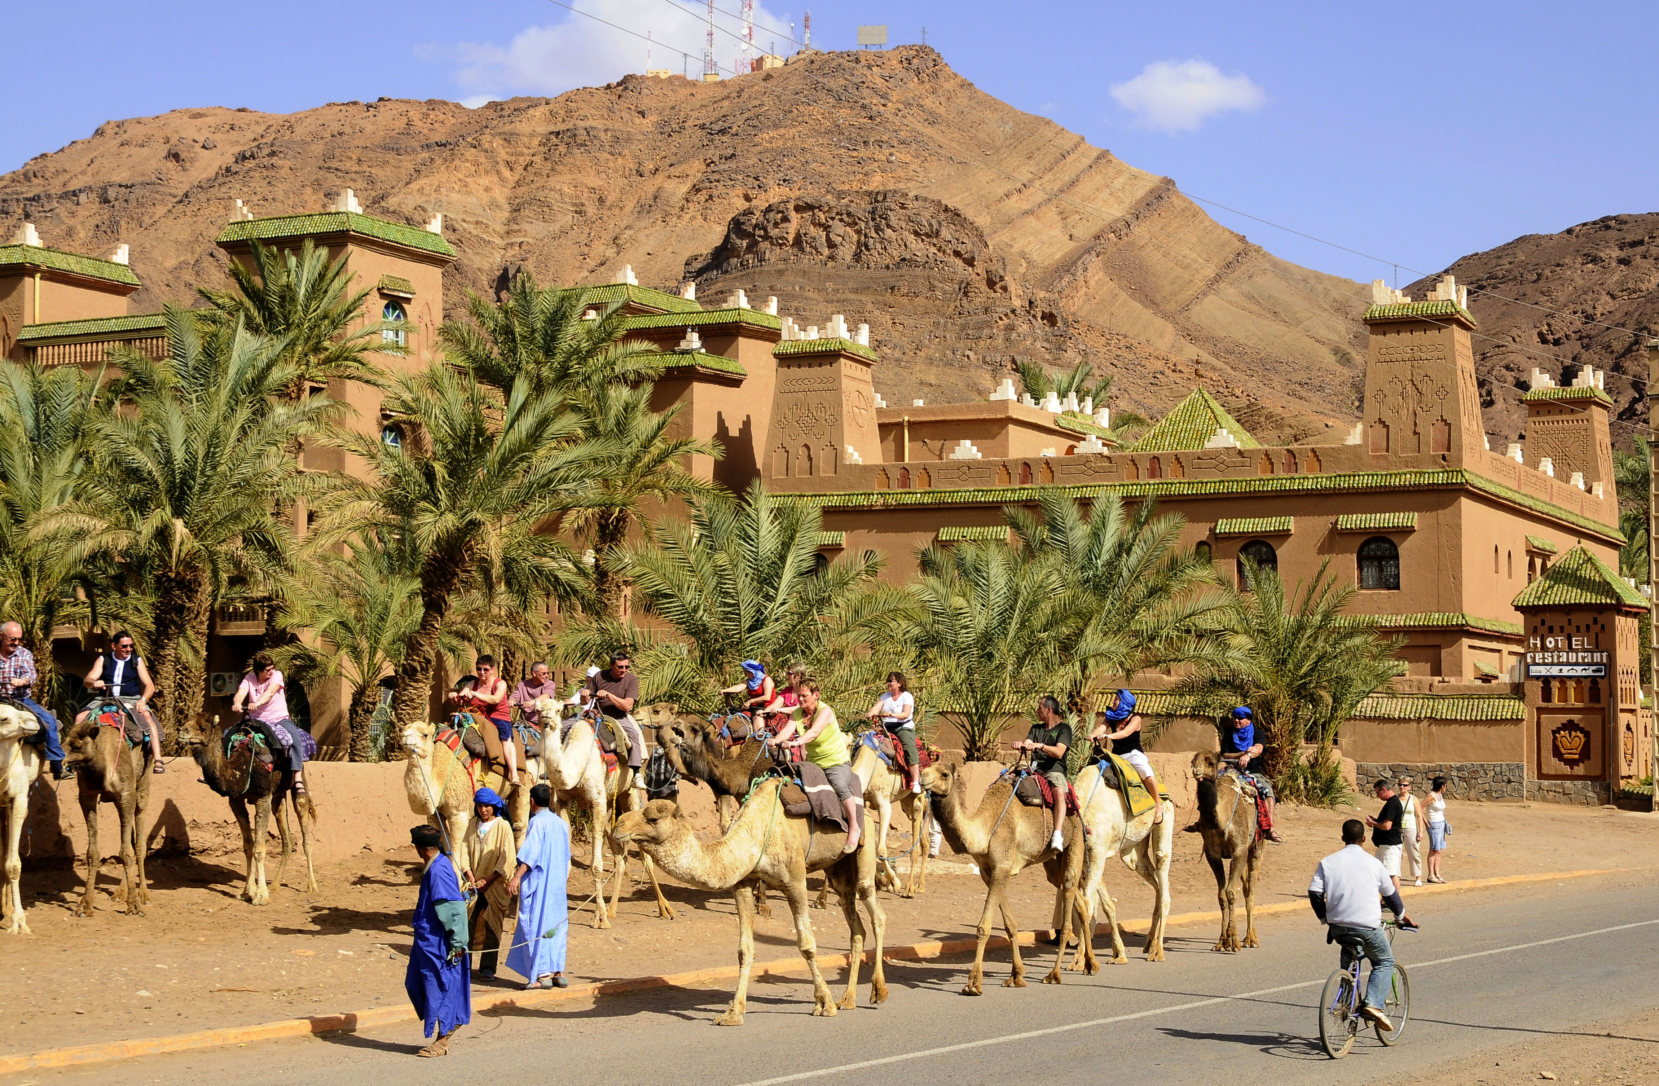
Tourism
In 2019, over 13 million tourists visited Morocco. The tourism industry employs 750,000 people and represents about 7% of the country’s GDP (about US$9 billion).
Whilst most tourism is focused on the northern cities, increasing numbers choose to travel to the High Atlas and the Sahara Desert.
The Draa valley offers many attractions to tourists, including the favourable climate, rich Berber cultural heritage, historic kasbahs (fortresses), spectacular desert and mountain landscapes and opportunities for adventure tourism.

Slide 6
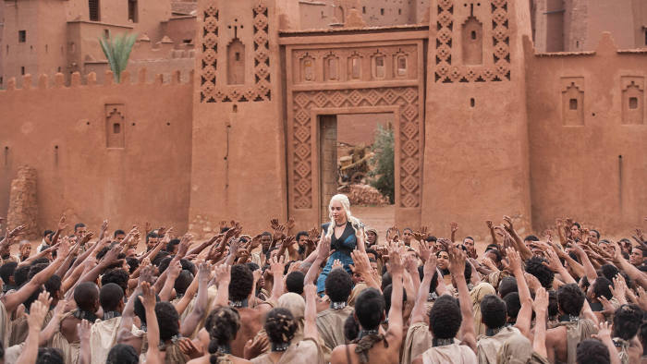
Film making at Ouarzazate
Ouarzazate is the centre of a thriving film industry. Films shot in the area include Lawrence of Arabia (1962), The Living Daylights (1987), Gladiator (2000) and scenes in Game of Thrones.
The area offers an ideal climate (good light and guaranteed sunshine), spectacular desert landscapes, historic buildings, a stable government and highly qualified technicians.
The Atlas Studios, the largest (by area) film studio in the world, is locate a few miles outside Ouarzazate.
Source: https://www.ft.com/content/8222b7e8-5c25-11e7-b553-e2df1b0c3220

Slide 7
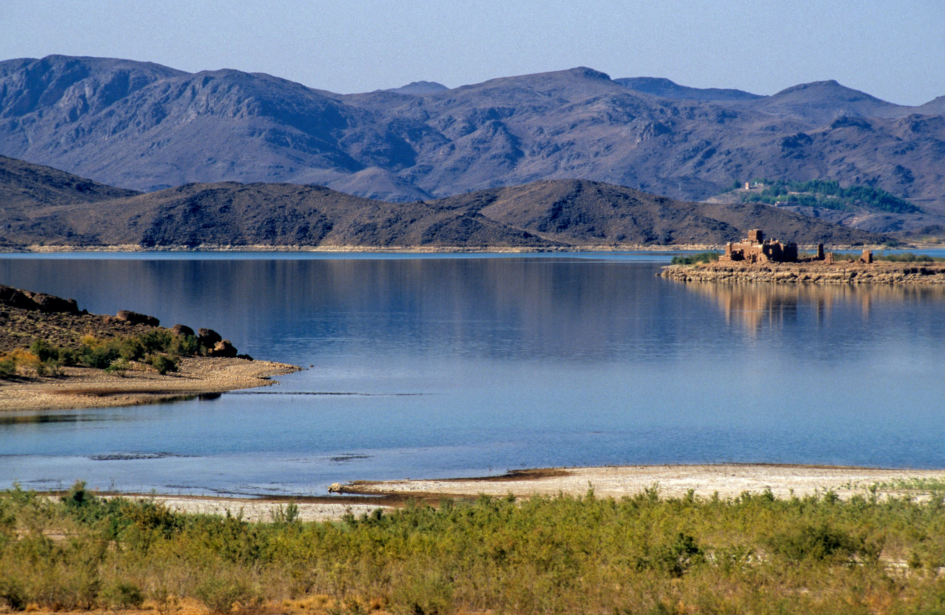
Resources - water
Constructed in 1971, the El Mansour Eddahbi Dam to the east of Ouarzazate regulates the flow of the Draa river.
Capable of holding back 500 million cubic metres of water (equivalent to 2.5 billion domestic bathtubs), the dam helps to guarantee year-round water for domestic use and irrigation.
The construction of the reservoir involved flooding 1,000 acres of farmland and the relocation of 8,000 people. Since its construction, silting has reduced the reservoir’s capacity by 50%. Reduced flow downstream has affected poorer small farms.

Slide 8
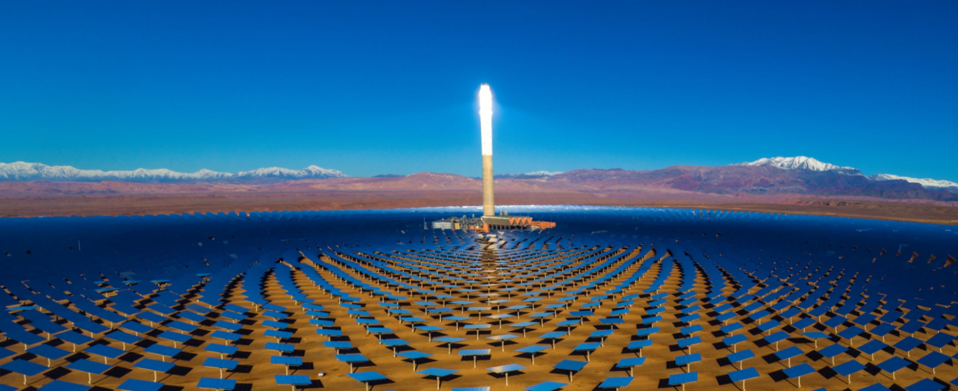
Resources - energy
The Noor Power Plant near Ouarzazate is the world’s largest solar power plant. In total, the solar farm occupies 2,500 hectares.
The location is ideal for a solar power plant. The area has the highest hours of sunshine in the world and its flat and expansive landscape is perfect for construction.
Commissioned in 2016, delivery of electricity to the national grid began in 2018. The power plant will supply a significant amount of clean energy, reducing Morocco’s greenhouse gas emissions. Energy can also be exported to Algeria, Tunisia, Libya and Egypt.
The total cost of the project is about US$2.5 billion.

Slide 9
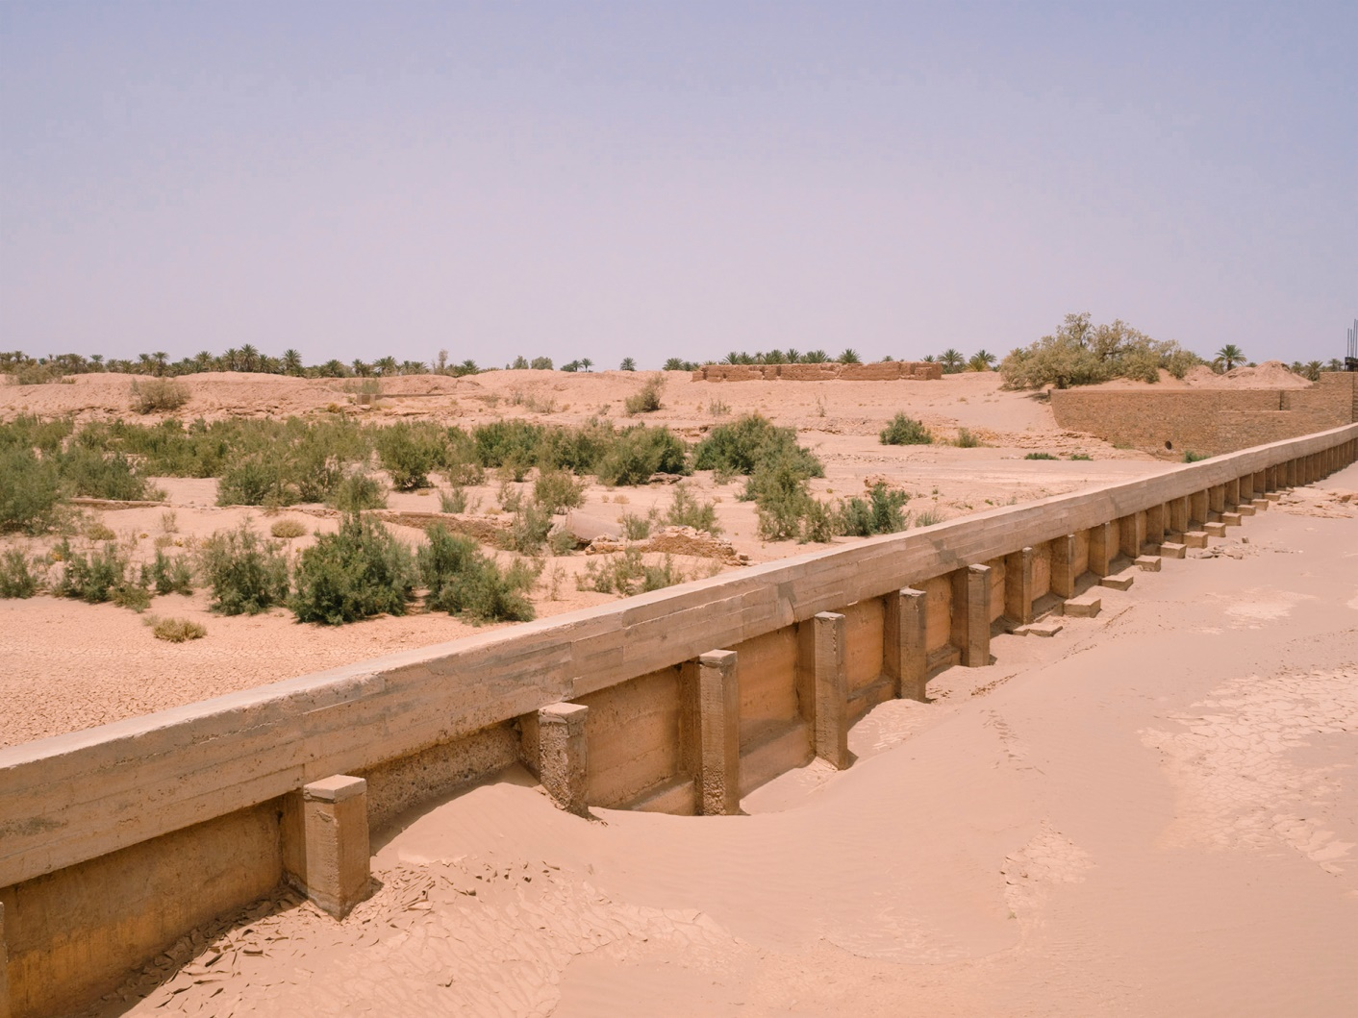
Challenges of development
The Draa valley is experiencing several environmental issues, such as water shortages, salinisation, desertification and drought.
Precipitation has declined in the High Atlas with less snow in the winter
Water demand for commercial irrigation and tourism has increased
Population has grown particularly in towns such as Ouarzazate, increasing water demand
Poor irrigation techniques have resulted in salinisation, where evaporation forms a hard and infertile salty crust on the surface
Reduced outflow from the El Mansour Eddahbi Dam has contributed to water shortages downstream.
Source: http://paulinelerolland.com/ux-portfolio/desertification-morocco/

