Slide 1

Hot Deserts
An Introduction
+44 (0)1883 744392 www.discover-morocco-online.com
info@discover.ltd.uk

Slide 2
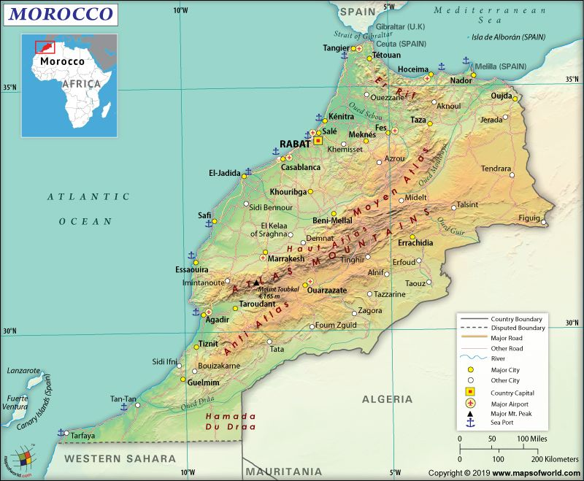
Where are Morocco’s hot deserts?
The Atlas Mountains form the central
spine of Morocco, running roughly NE-SW
Mount Toubkal (4,167m) is the highest peak
in the Atlas Mountains
To the south of the Atlas Mountains is the
northern edge of the Sahara Desert
Sahara Desert
https://in.pinterest.com/pin/281686151682043139/

Slide 3
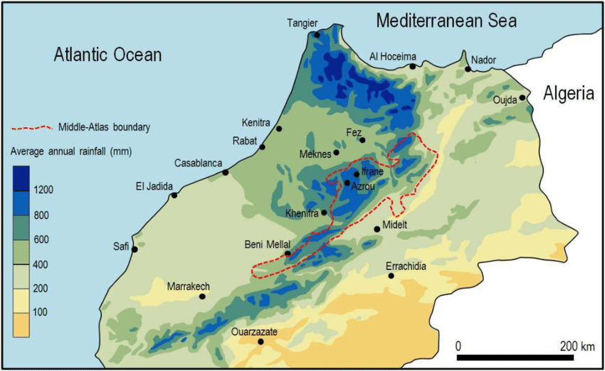
Morocco: rainfall patterns
A desert is commonly defined as having less
than 250mm annual rainfall
In Morocco, the most extensive true desert is
the Sahara Desert in the far south. Here, the
annual rainfall is less than 100mm.
Elsewhere there are many semi-arid deserts
where conditions are less extreme,
experiencing 100-300mm annual rainfall
Rainfall is highest in the north of Morocco
and over the High Atlas Mountains
Sahara Desert
https://www.researchgate.net/figure/Spatial-distribution-of-average-annual-rainfall-1961-1990-in-northern-Morocco_fig1_324695640

Slide 4
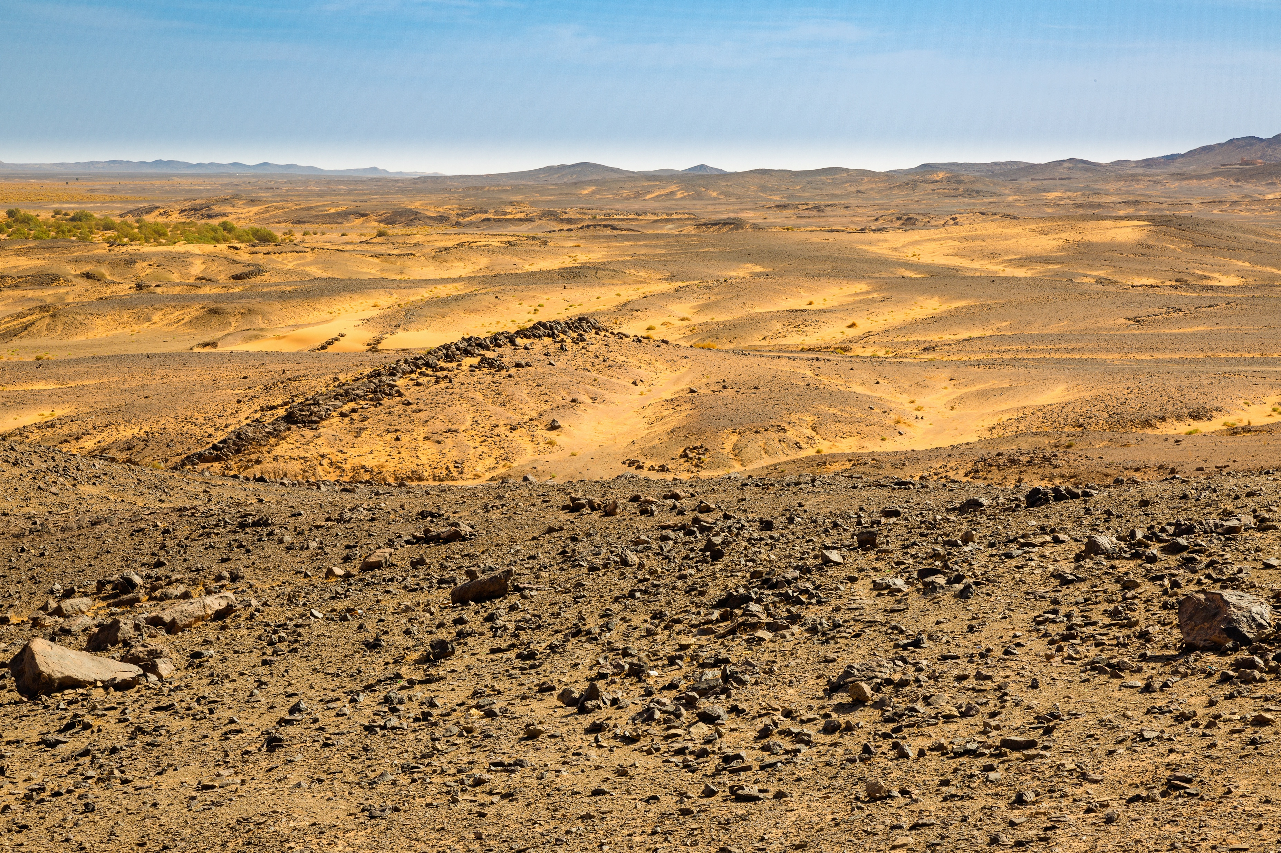
What are Morocco’s deserts like?
In Morocco, many areas of desert are bare
and rocky
This type of desert is known as hamada
Notice the sharp, angular rock fragments.
They are called ventifacts and are formed
by wind erosion.

Slide 5
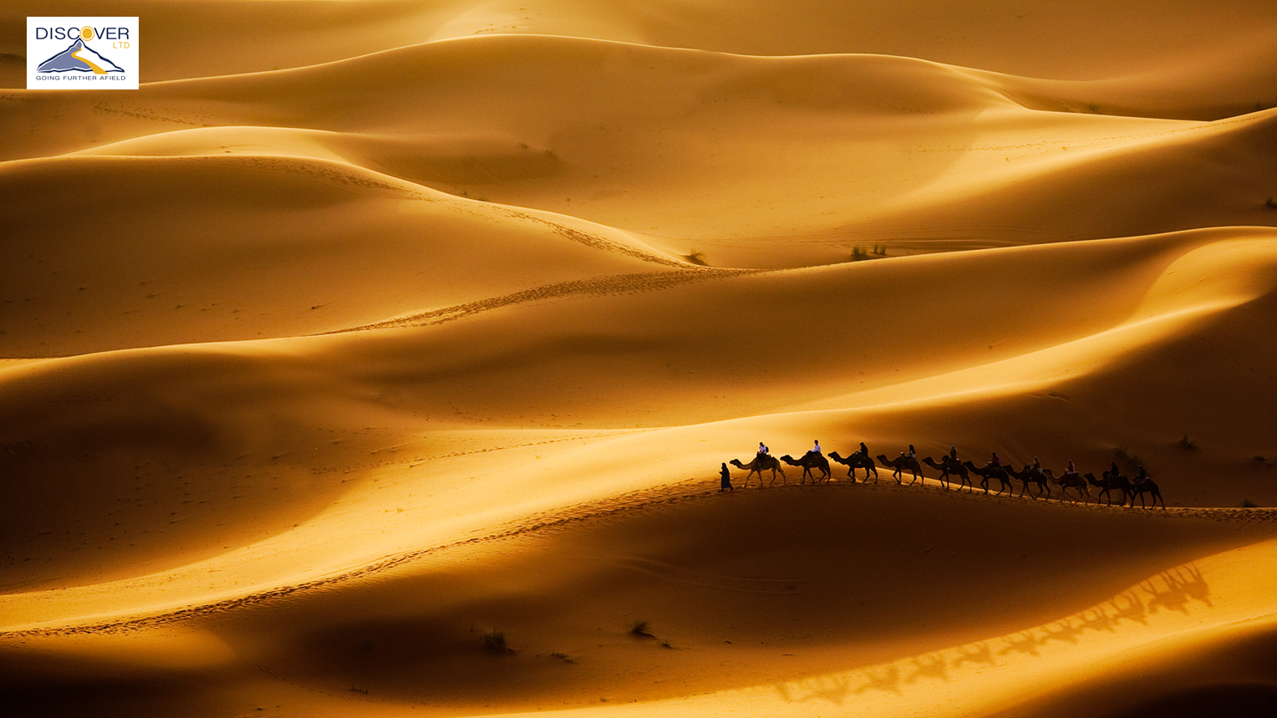
Camel train in the Sahara Desert
In the Moroccan Sahara, there are some
magnificent sandy deserts, called ergs
These large ‘sand seas’ of dunes have been
formed over thousands of years by wind-blown
sand
In Morocco, sand dunes are very popular
destinations for tourists

Slide 6
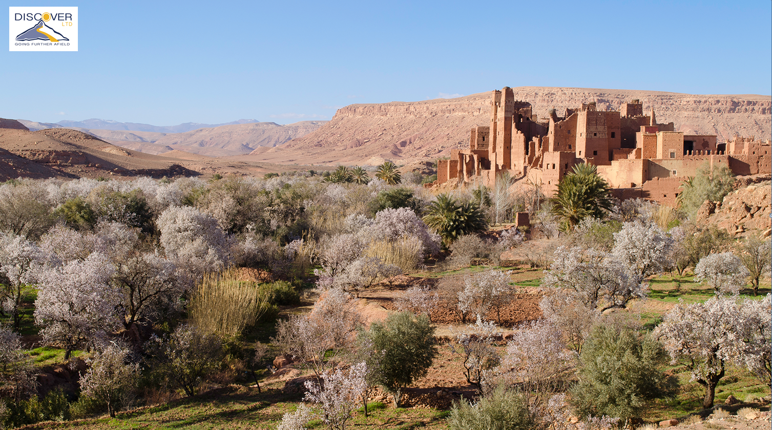
Semi-arid desert near Ait Benhaddou
In this semi-arid landscape, the presence of
water (Ounila River) creates an oasis
Here, there is a garden of fruit trees
(apples, almonds and dates) and crops
The building with the towers is Glaoui
Kasbah, now a ruin. It lies on an ancient
trading route to Telouet.

Slide 7
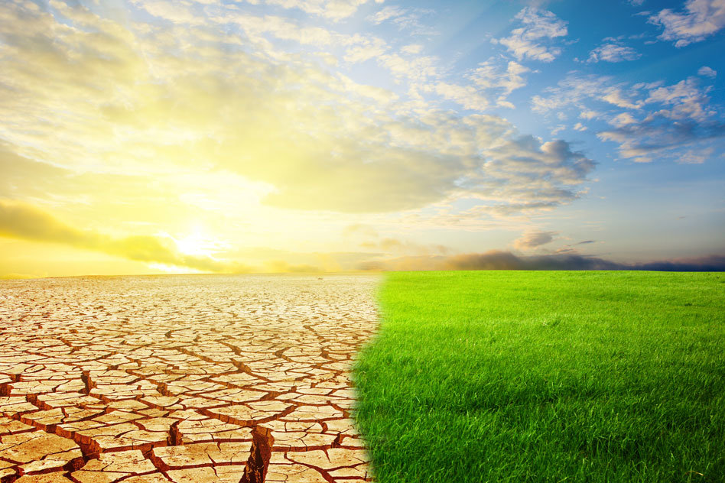
How was the Sahara formed?
Scientists believe the origins of the Sahara
go back about 7 million years. At this time,
tectonic forces driving the African plate
northwards closed off a great sea called Tethys.
Replacing water with land (which reflects more
sunlight), precipitation patterns were altered and
the region became more arid (dry)
Since then, periodic ‘wobbles’ in the Earth’s tilt
have resulted in alternating wet and dry periods
Between 11,000-5,000 years ago, the Sahara
was more humid, with forests, lakes and vast
areas of grassland.
https://phys.org/news/2019-01-sahara-swung-lush-conditions-years.html

Slide 8
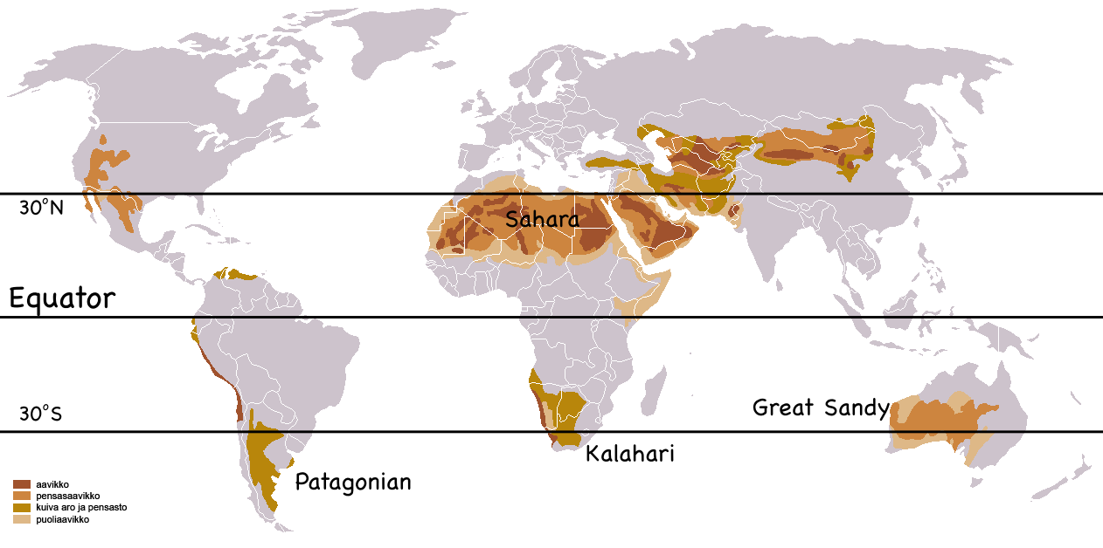
Why is the Sahara so dry today?
The Sahara is the largest hot
desert in the world covering
an area of 9.2 million km²
Notice that the world’s deserts
are located close to the 30°
line of latitude in both
hemispheres
At this latitude, as part of the
global atmospheric circulation,
air descends towards the
ground.
https://montessorimuddle.org/2011/04/21/global-atmospheric-circulation-and-biomes/

Slide 9
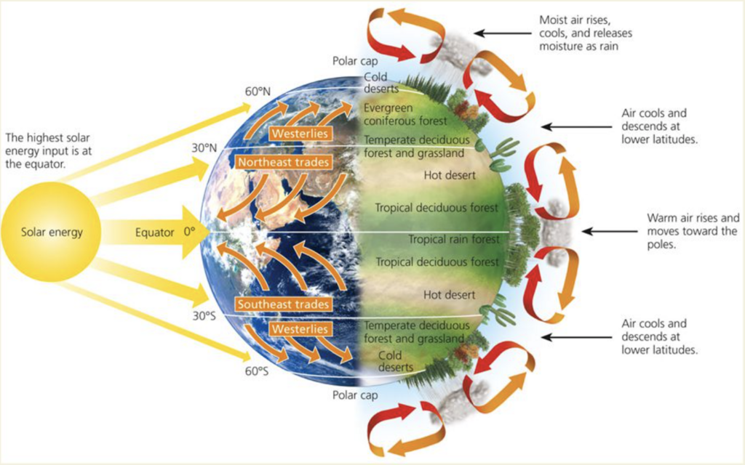
Why is the Sahara so dry today?
Driven by heat from the sun, the atmosphere circulates as a series of cells or cycles
Notice that the high temperature at the Equator causes air to rise. This accounts for the heavy rains and the presence of tropical rainforests.
This rising air travels north and south, cooling and eventually sinking at about 30°
It is this cool and dry descending air that explains the aridity at these latitudes and the presence of the world’s deserts
https://quizlet.com/218676746/unit-3-contested-planet-a1-global-atmospheric-circulation-diagram/

