Slide 1

Desert landscapes
Northern Sahara Desert, Morocco
+44 (0)1883 744392 www.discover-morocco-online.com
info@discover.ltd.uk

Slide 2
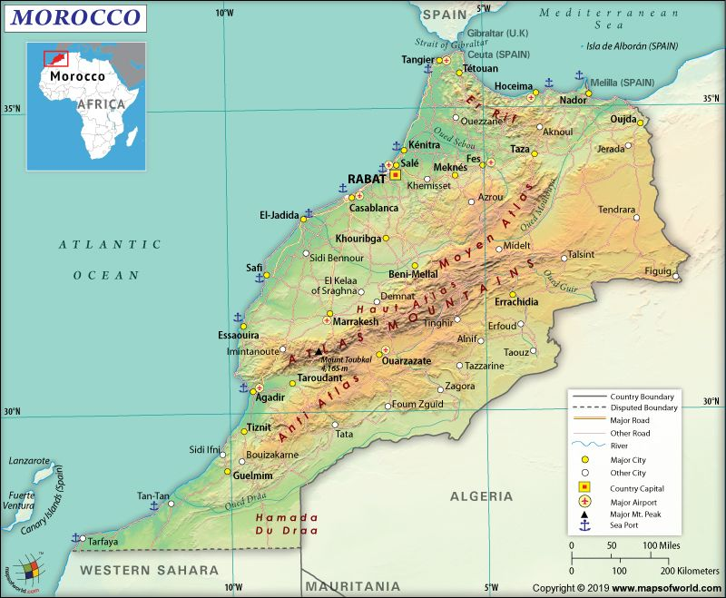
Where are Morocco’s hot deserts?
The south-east of Morocco, beyond the High Atlas Mountains, forms part of the fringe of the Sahara Desert.
Travelling south, the landscape becomes increasingly arid, vegetation is sparse and settlement is often confined to oases alongside rivers.
In this region of Morocco there is the opportunity to investigate several different desert landscapes, especially between Ouarzazate and Zagora.
Sahara Desert
https://in.pinterest.com/pin/281686151682043139/

Slide 3
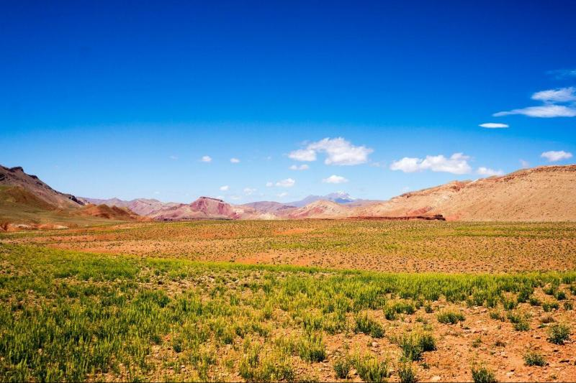
What are desert landscapes?
Deserts are characterised by distinctive landscapes, mainly due to their aridity and high temperatures, lack of vegetation and poorly developed soils.
The Sahara has low and very irregular rainfall and is one of the hottest places in the world. Day-time temperatures may reach over 50ºC; nights are cooler and frost may be experienced during the winter.
The processes of weathering, erosion, transportation and deposition are distinctive, producing a variety of different landforms.
https://www.grayline.com/tours/marrakech/ouarzazate-and-desert-mhamid-3-days-2-nights-5969_9_12130_419/

Slide 4
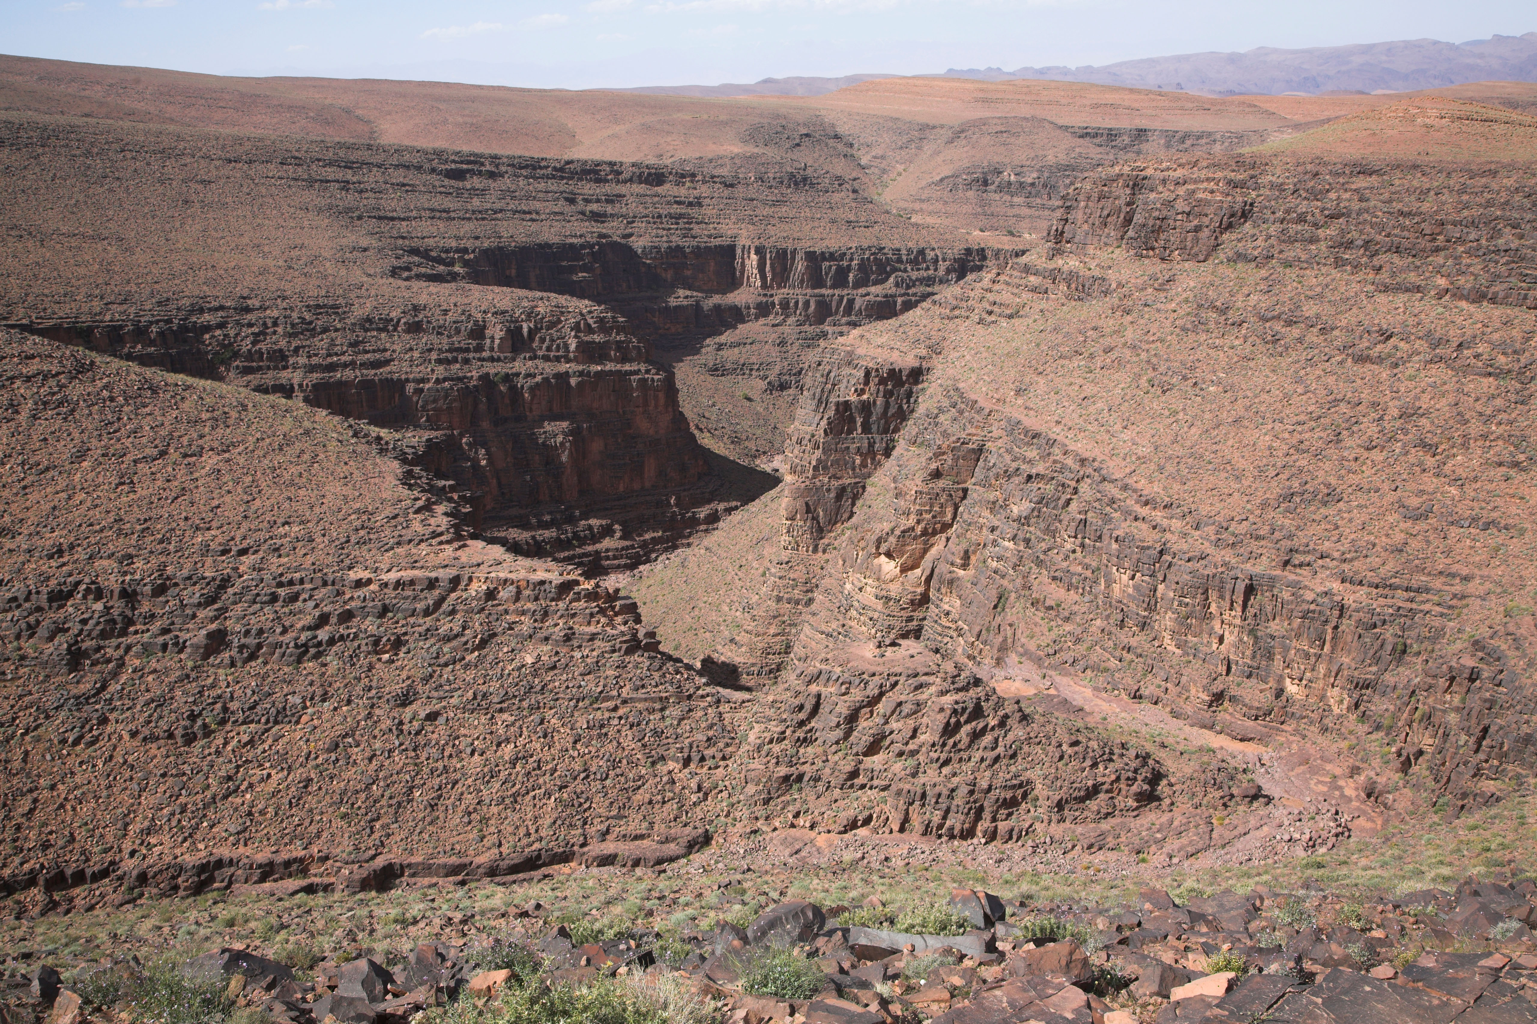
Desert gorges (canyons)
Mountain regions in deserts are often incised by narrow, steep-sided valleys, or gorges. They may or may not have a river at the bottom.
The photo shows the Tiz-n-Tinififft pass near Ouarzazate, a gorge cut into gently-dipping sedimentary rocks of the mountain plateau.
Morocco’s gorges are formed by rapid vertical erosion involving vigorous fast flowing rivers.
Today the gorge is normally dry, but it can carry substantial runoff following heavy rainfall and shows evidence of rapid vertical fluvial erosion.

Slide 5
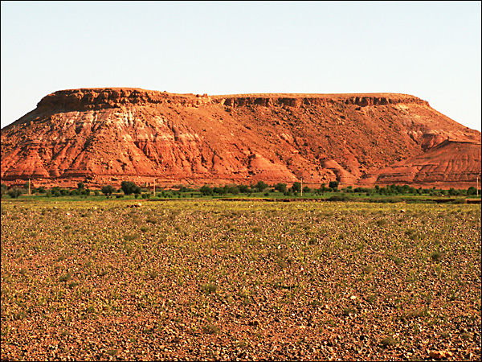
Mesas and buttes
The landscape to the west of Ouarzazate is dominated by wide alluvial plains and pediments above which rise isolated flat-topped hills, or mesas.
A mesa is an isolated hill or mountain that has a flat, table-like top and steep sides, edged by cliffs. Buttes are smaller than mesas and have a more uniform shape.
Mesas and buttes form in areas of horizontally-bedded rocks; the flat top is formed by a more resistant ‘cap rock’.
Mesas and buttes were originally parts of extensive plateaus worn away by erosion over long periods of time.
(Source: Desert landscapes Discover 2016)

Slide 6
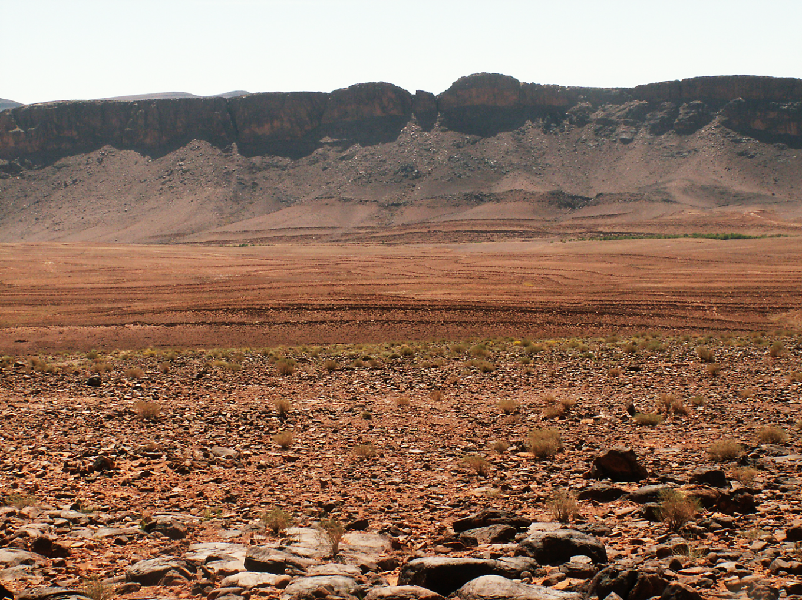
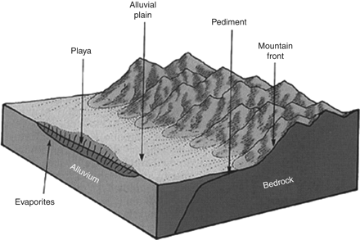
Alluvial fans, plains and pediments
The mountain edge at Zagora displays classic desert landforms including alluvial fans (cone-shaped water deposits), extensive alluvial plains and rocky pediments.
The pediment is a slope of deposition and transportation over which debris eroded from the mountain front is moved by sheet flooding.
The surface of the pediment is covered with coarse sediment, forming a reg or desert pavement of loose stones.
https://egsp.lyellcollection.org/content/25/1/33
(Source: Desert landscapes Discover 2016)

Slide 7
Formation of desert pavement
The stony desert pavement or reg is a characteristic of pediments near Ouarzazate.
Whilst water is responsible for the deposition of the sediment, the concentration of larger pebbles results from deflation, a process associated with wind.
Deflation occurs when winds blow across a bare desert surface selectively picking up fine sand and silt particles, leaving behind larger sediments to form a pebble-strewn desert pavement, or reg.
(Source: Desert landscapes Discover 2016)

Slide 8
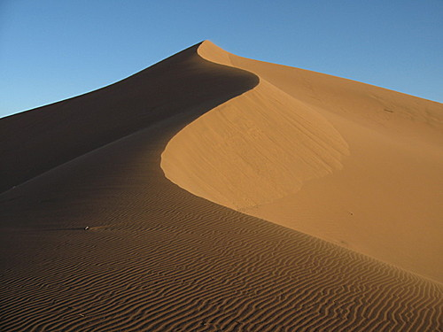
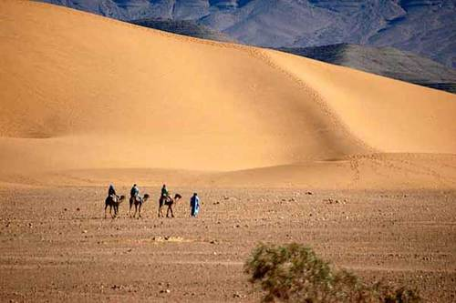
Sand dunes - ergs
Sand, which has been eroded and transported from desert surfaces, may be deposited to form sand dunes.
A dune field is an area covered by extensive sand dunes; large dune fields are known as ergs.
It is estimated that 25% to 30% of the world’s deserts are covered by aeolian sand and large ergs are to be found in the north-west Sahara near Zagora.
The geometric forms of sand dunes are very varied and depend on factors such as the supply of sand, the wind regime, the extent of vegetation cover, moisture content and the shape of the ground surface.
Sand dunes near Zagora
(Source: Desert landscapes Discover 2016)

Slide 9
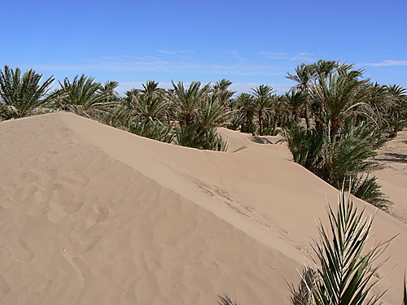
Sand dune encroachment
The deposition of sand is a problem at Tinfou where fields and buildings have been buried by sand. The photo shows irrigated date palm groves partly buried by sand.
Sand encroachment is probably related to the process of desertification and the removal of vegetation cover from the desert plains by human activity.
Most of the sand here at Tinfou is believed to be of local origin, transported by the wind.
(Source: Desert landscapes Discover 2016)

